Slide 1

SHRI VAISHNAV VIDYAPEETH VISHWAVIDYALAYA, INDORE
SHRI VAISHNAV INSTITUTE OF INFORMATION & TECHNOLOGY
JANUARY-JUNE (2022)
Program:- B.tech, Department:- IT, Section:- “B”, Semester:- 6th
PRESENTED BY: - Vijay Sahu [19100BTIT06635] (G- leader )
G- Members :- Rishabh raj [19100BTIT06601]
Rishabh Patidar [19100BTIT06599]
Prashant Vishwakarma [19100BTIT06591
PRESENTED TO: - PROF. GAURAV VINCHURKAR / PROF. RICHA JAIN

Slide 2
Minor Project Name
ONLINE EXAMINATION SYSTEM

Slide 3
Introduction
A fully functional project based on Online Examination System which uses Python with Django Web Framework. Following the Django project contains all the important features that can be used for the exam. It has several important features that will allow the users to attend online exams and manage them. This system as well as the web application’s concept is all clear, it’s the same as real-life scenarios and well-implemented on it.

Slide 4
Tools & Technology :
Project Name: | Online Examination System
Language/s Used: | Python with Django Web Framework
Database: | SQLite
Type: | Web Application

Slide 5
Available Features:
Student Panel
Teacher Panel
Admin Panel

Slide 6
Requirement on System
python interpreter
Browser
asgiref==3.2.7
Django==3.0.5
django-widget-tweaks==1.4.8
pytz==2020.1
sqlparse==0.3.1
Pillow

Slide 7
Admin Panel
an admin has full control of the system. An admin manages the flow of the system, unlike every other user. The user can have an overview of each data. The admin has the right to approve/decline the teacher’s account.

Slide 8
Teacher Panel
Talking about the teacher panel, each and every user needs approval from the administration in order to activate their accounts. Once after getting approval, he/she can access the system and manage courses with their question sets.

Slide 9
Student Panel
Talking about the teacher panel, each and every user needs approval from the administration in order to activate their accounts. Once after getting approval, he/she can access the system and manage courses with their question sets.

Slide 10
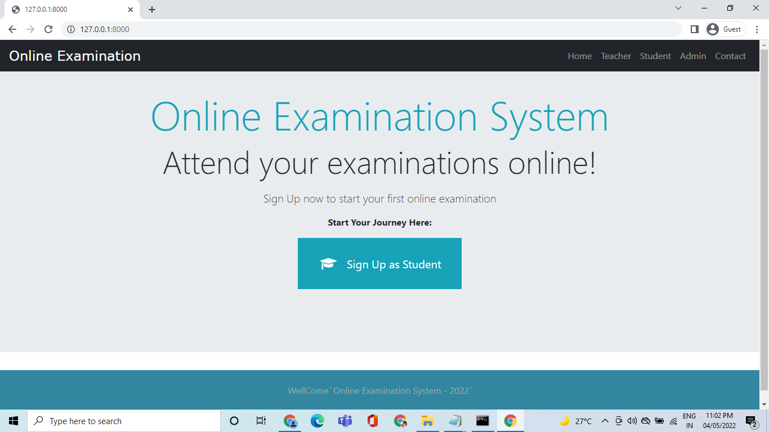
Student Panel

Slide 11
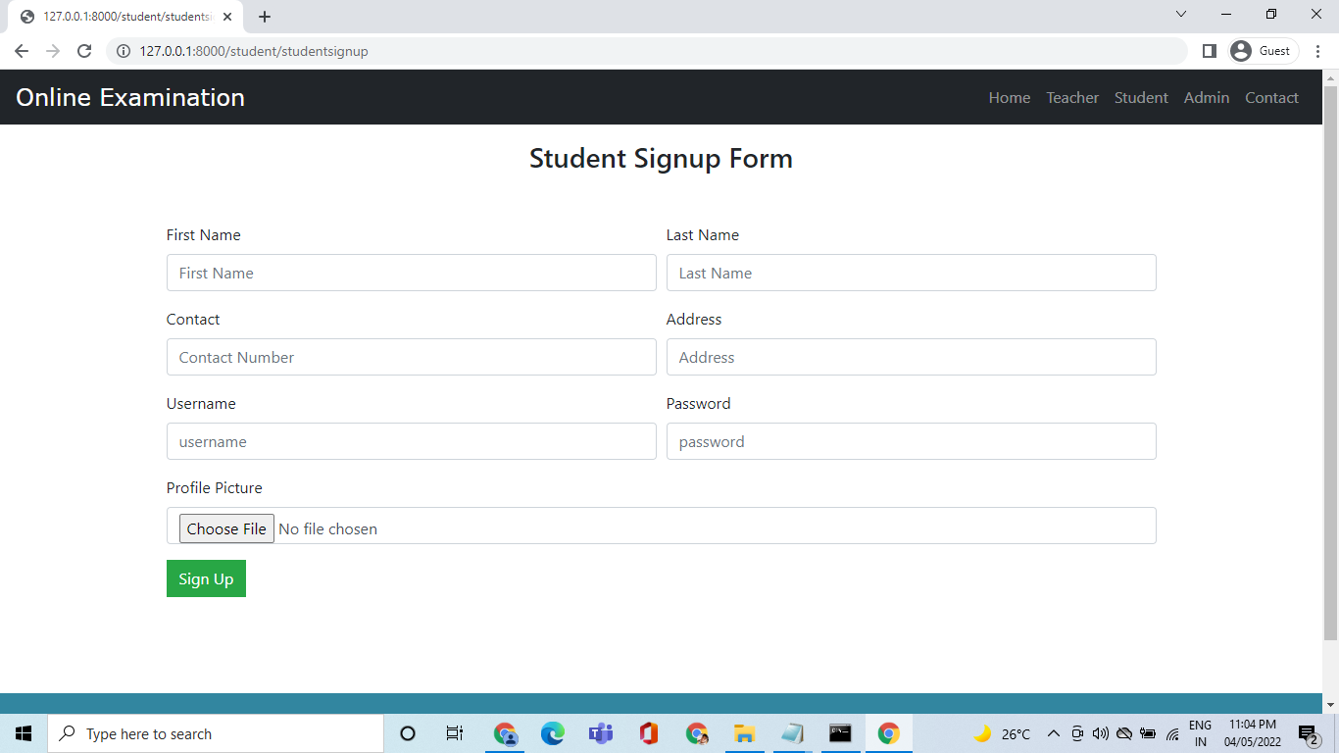
Student sign up Panel

Slide 12
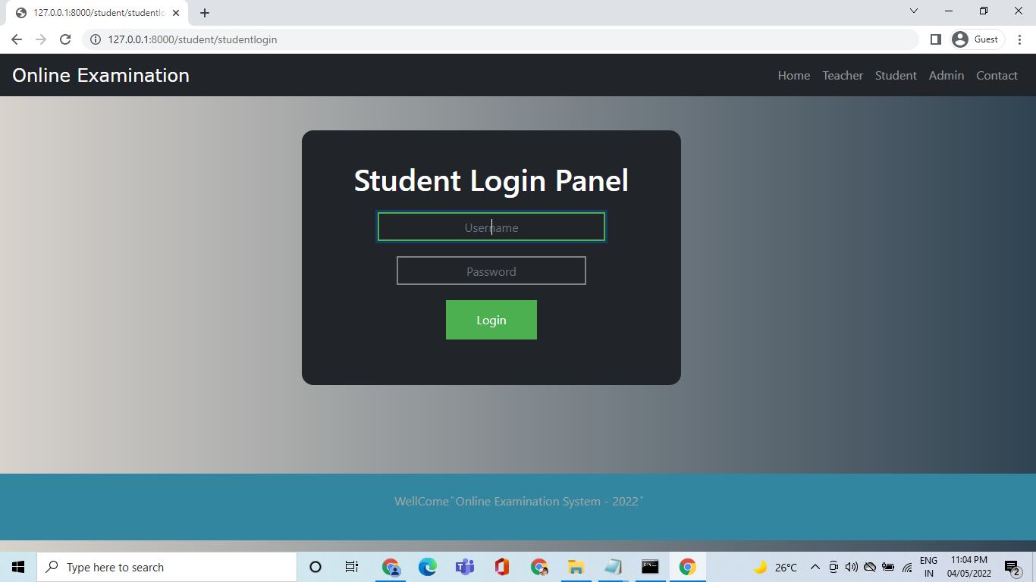
Student login Panel

Slide 13
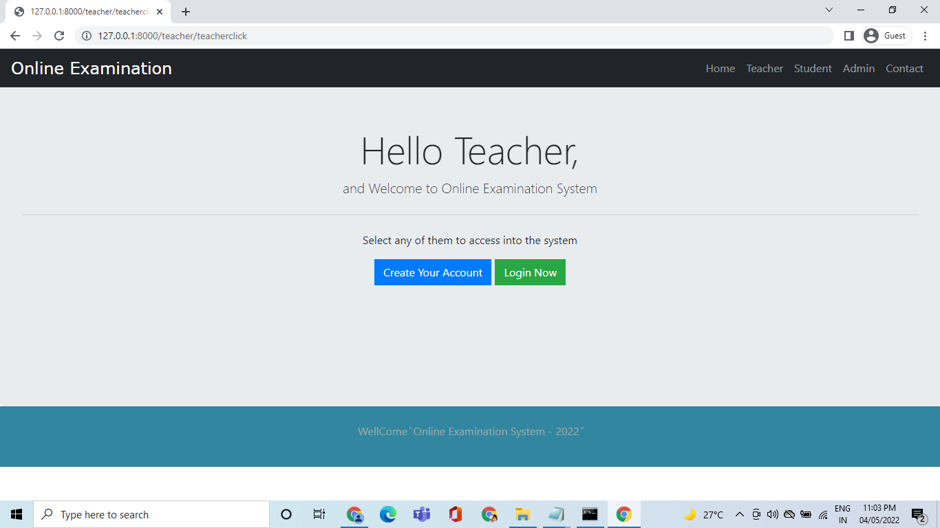
Teacher Panel

Slide 14

Teacher sign up Panel

Slide 15
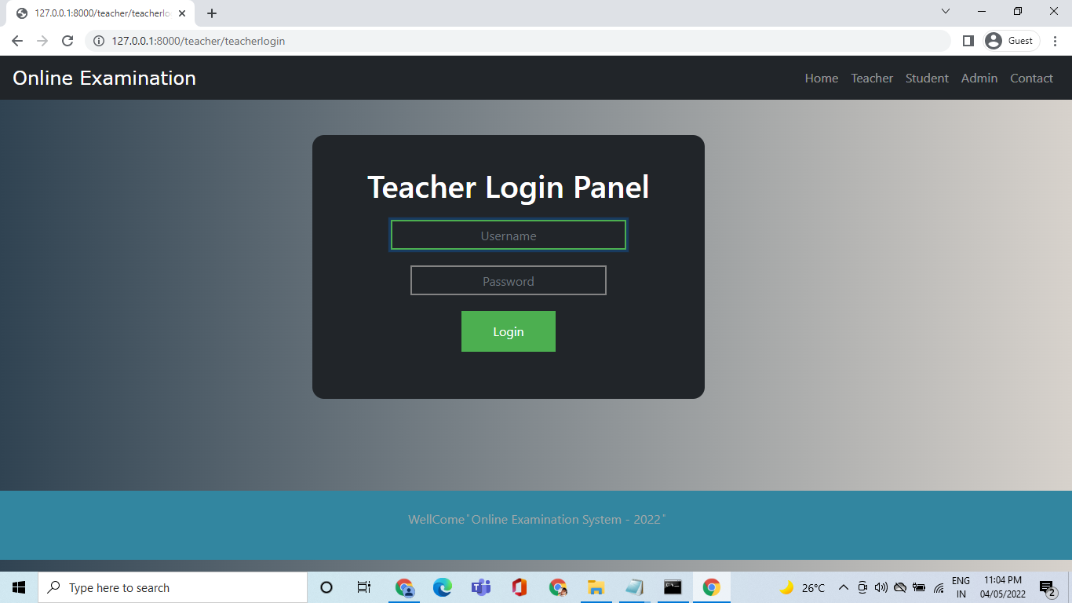
Teacher login Panel

Slide 16
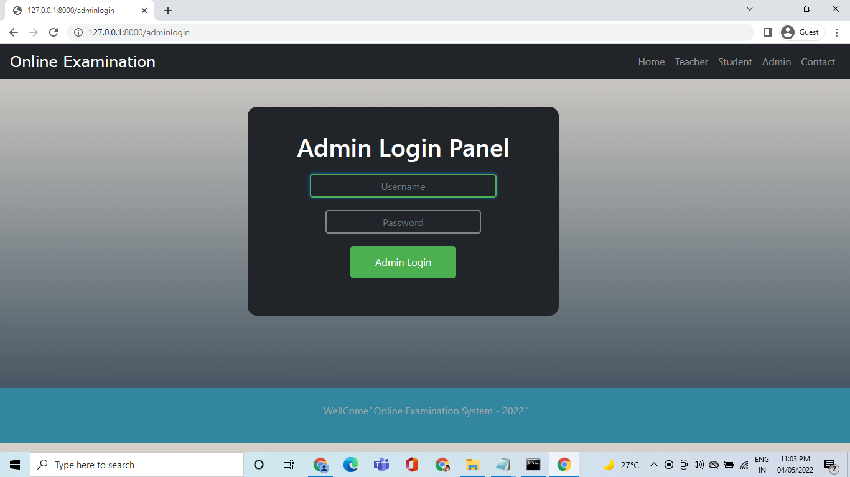
Admin Login Panel

Slide 17
Thanks

